Slide 1
BIEN 401 Biomedical Mass Transport Class 21 Wrap-Up
notes prepared by
Dr. Louis Reis
Created on 5/1/2022

Slide 2
Limitations of Bioartificial Organs and Tissue Constructs
As we saw with bioartificial organs and tissue engineered constructs, the thickness of the cell or tissue layer is limited by the diffusion and consumption of oxygen in the cell/tissue layer.
We saw that the thickness (or half thickness) may be limited to just a few cells thick.
Researchers have looked ways to increase oxygen concentrations either through in situ generation (i.e., specialized cells in the tissue layer produce oxygen) or through periodic injections.
Another approach is the use of _________________.

Slide 3
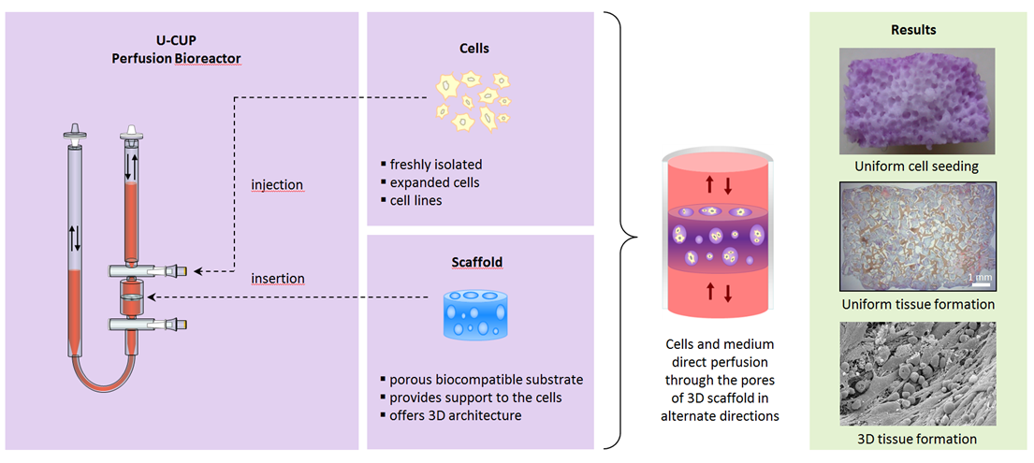
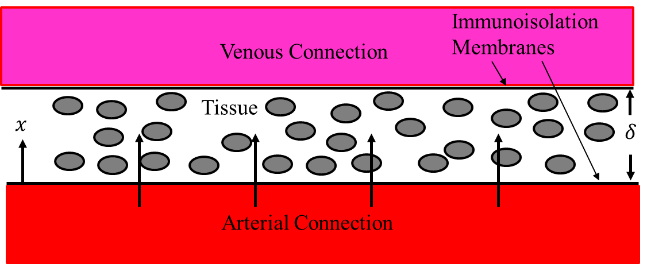
Perfusion Bioreactors
Perfusion bioreactors are similar to bioartificial organs except they are installed and connected between an artery and vein.
A microporous membrane allows for the ______ filtrate and small molecules (e.g., oxygen) to pass through from the artery side.
The equations are similar to the ones derived for bioartificial organs but now include a ____________ term.

Slide 4
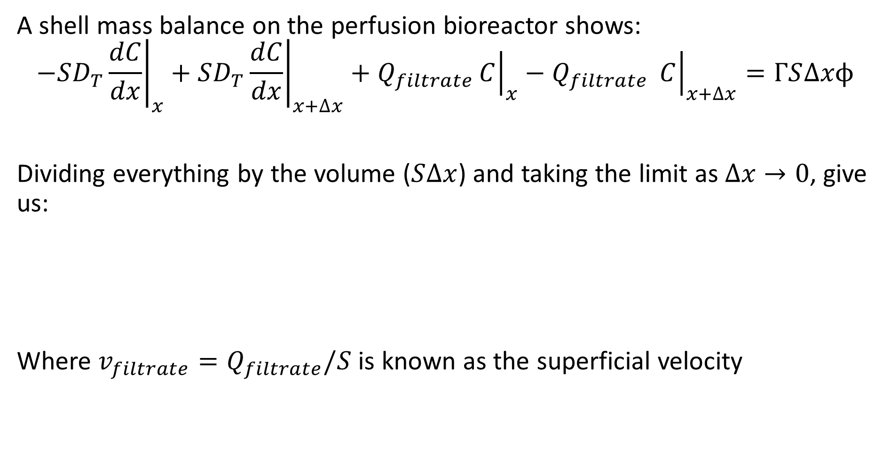
Perfusion Bioreactors – Mass Balance
A shell mass balance on the perfusion bioreactor shows:
$${\left.−SD_{T}\frac{dC}{dx}\right|}_{x}+{\left.SD_{T}\frac{dC}{dx}\right|}_{x+∆x}+Q_{filtrate}{\left.C\right|}_{x}−Q_{filtrate} {\left.C\right|}_{x+∆x}=ΓS∆xϕ$$
Dividing everything by the volume ($S∆x$) and taking the limit as $∆x→0$, give us:
Where $v_{filtrate}=Q_{filtrate}/S$ is known as the superficial velocity

Slide 5
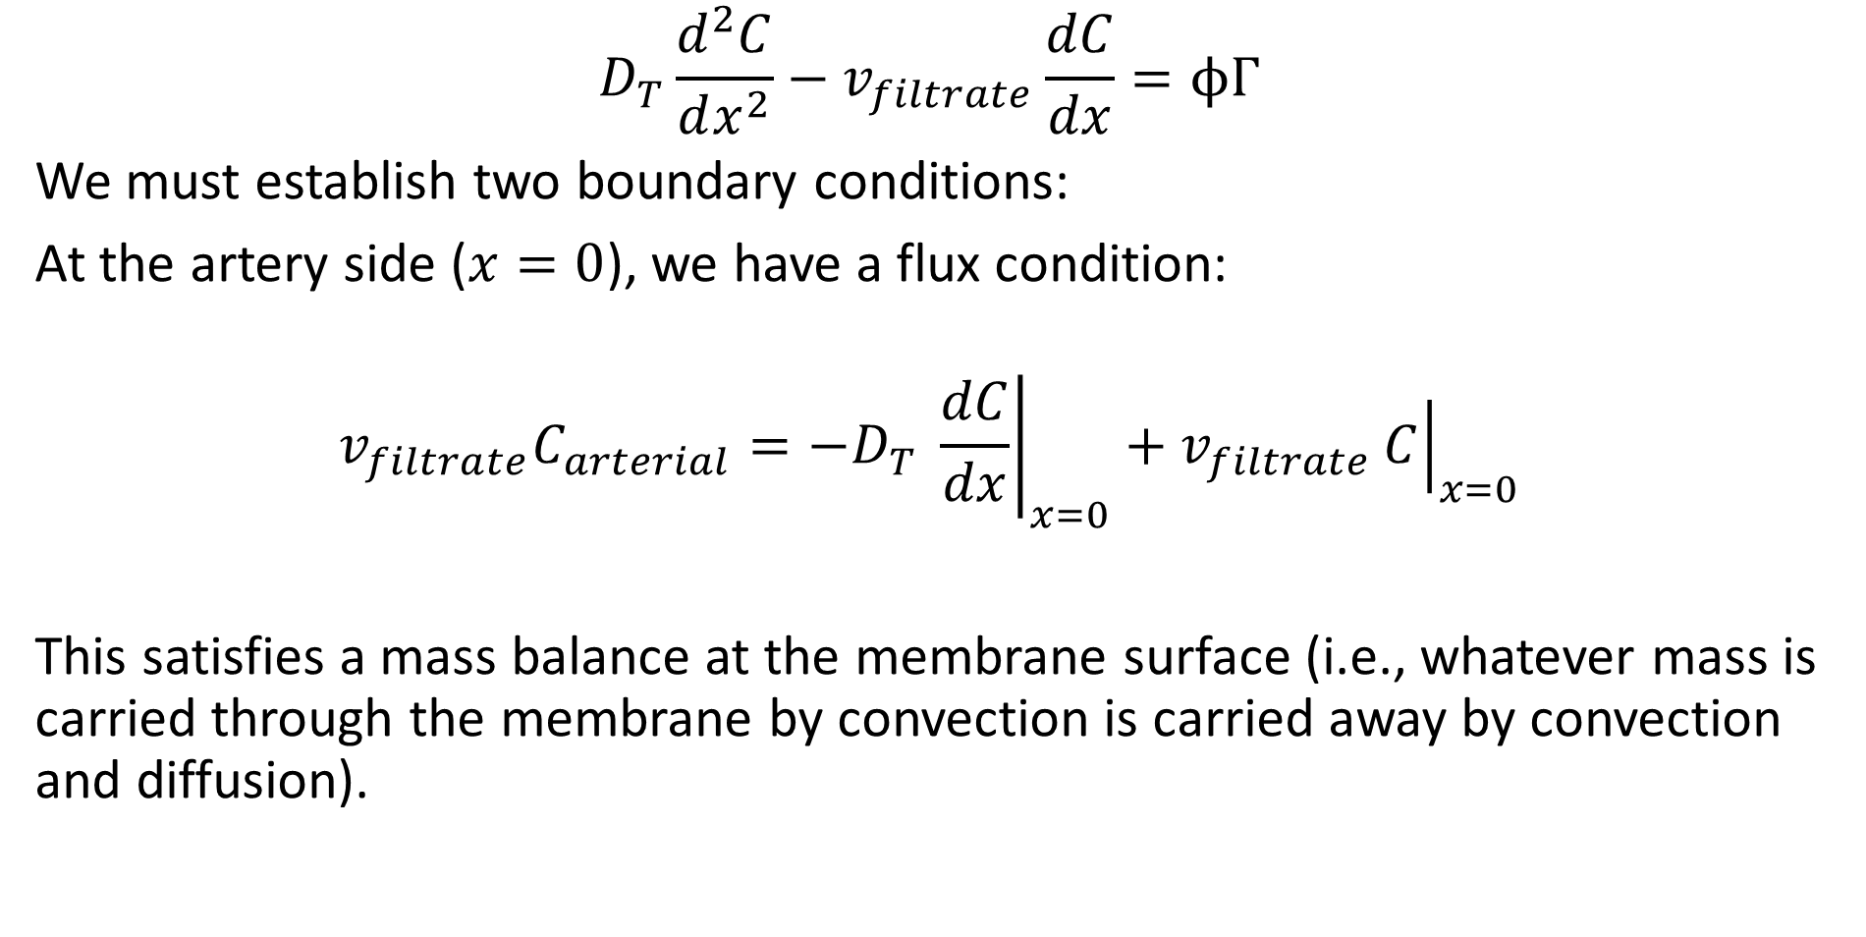
Perfusion Bioreactors – Boundary Conditions
$$D_{T}\frac{d^{2}C}{dx^{2}}−v_{filtrate}\frac{dC}{dx}=ϕΓ$$
We must establish two boundary conditions:
At the artery side ($x=0$), we have a flux condition:
$$v_{filtrate}C_{arterial}=−D_{T} {\left.\frac{dC}{dx}\right|}_{x=0}+v_{filtrate}{\left.C\right|}_{x=0}$$
This satisfies a mass balance at the membrane surface (i.e., whatever mass is carried through the membrane by convection is carried away by convection and diffusion).

Slide 6
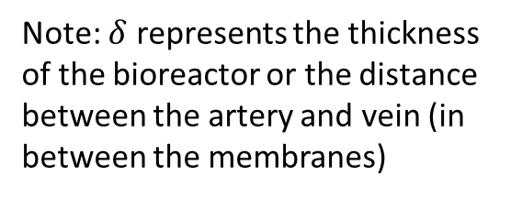
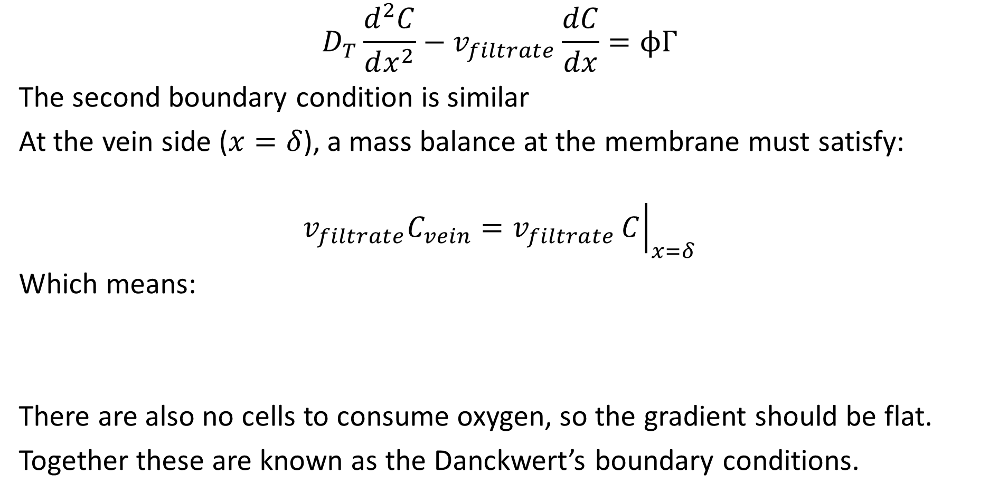
Perfusion Bioreactors – Boundary Conditions
$$D_{T}\frac{d^{2}C}{dx^{2}}−v_{filtrate}\frac{dC}{dx}=ϕΓ$$
The second boundary condition is similar
At the vein side ($x=δ$), a mass balance at the membrane must satisfy:
$$v_{filtrate}C_{vein}=v_{filtrate}{\left.C\right|}_{x=δ}$$
Which means:
There are also no cells to consume oxygen, so the gradient should be flat.
Together these are known as the Danckwert’s boundary conditions.
Note: $δ$ represents the thickness of the bioreactor or the distance between the artery and vein (in between the membranes)

Slide 7
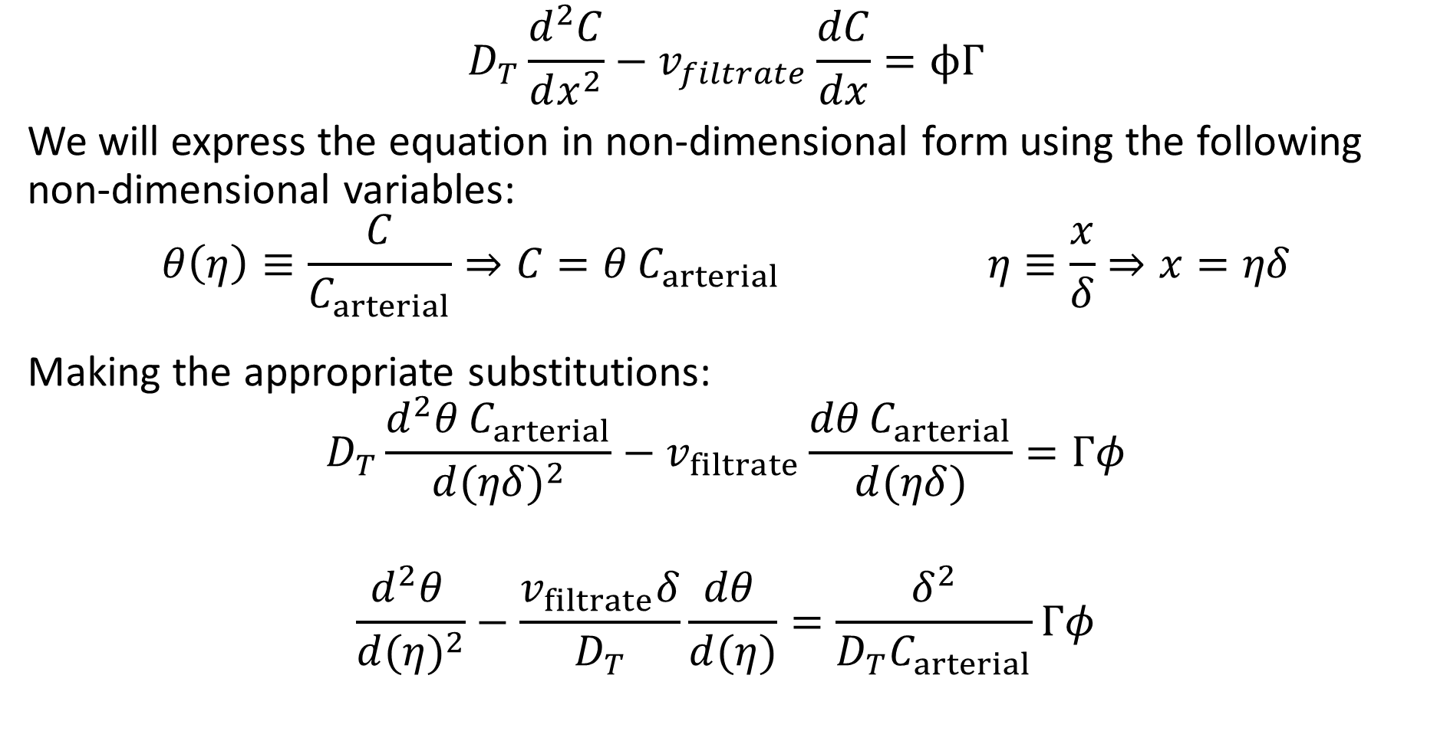
Perfusion Bioreactors – Mass Balance
$$D_{T}\frac{d^{2}C}{dx^{2}}−v_{filtrate}\frac{dC}{dx}=ϕΓ$$
We will express the equation in non-dimensional form using the following non-dimensional variables:
$$θ\left(η\right)≡\frac{C}{C_{arterial}}⇒C=θ C_{arterial} η≡\frac{x}{δ}⇒x=ηδ$$
Making the appropriate substitutions:
$$D_{T}\frac{d^{2}θ C_{arterial}}{d{(ηδ)}^{2}}−v_{filtrate}\frac{dθ C_{arterial}}{d(ηδ)}=Γφ$$
$$\frac{d^{2}θ }{d{(η)}^{2}}−\frac{v_{filtrate}δ}{D_{T}}\frac{dθ }{d(η)}=\frac{δ^{2}}{D_{T}C_{arterial}}Γφ$$

Slide 8
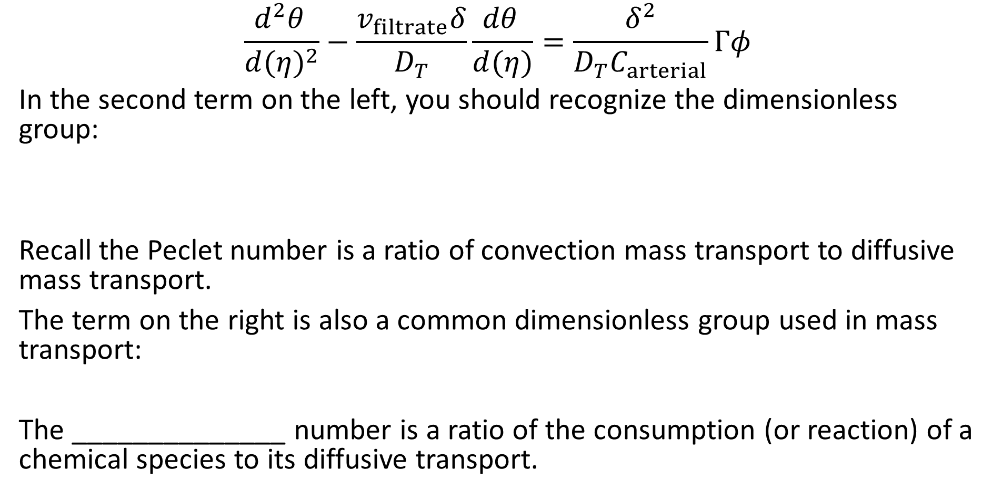
Dimensionless Groups
$$\frac{d^{2}θ }{d{(η)}^{2}}−\frac{v_{filtrate}δ}{D_{T}}\frac{dθ }{d(η)}=\frac{δ^{2}}{D_{T}C_{arterial}}Γφ$$
In the second term on the left, you should recognize the dimensionless group:
Recall the Peclet number is a ratio of convection mass transport to diffusive mass transport.
The term on the right is also a common dimensionless group used in mass transport:
The ______________ number is a ratio of the consumption (or reaction) of a chemical species to its diffusive transport.

Slide 9
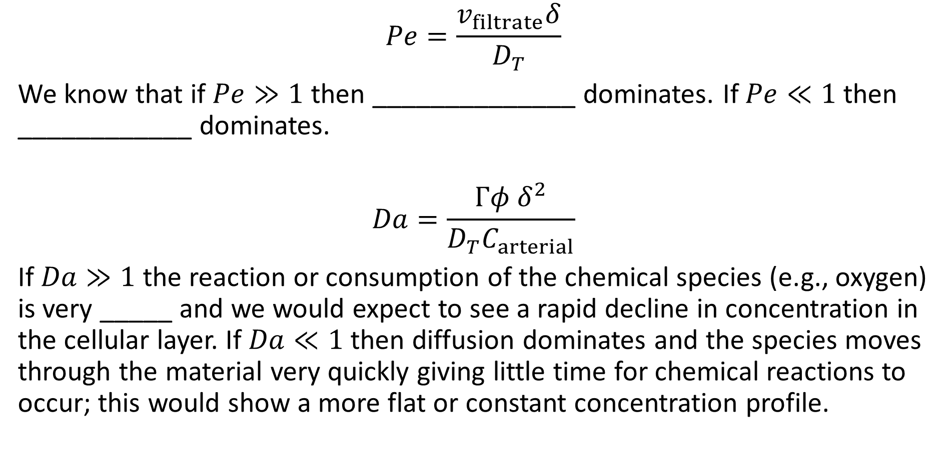
Dimensionless Groups
$$Pe=\frac{v_{filtrate}δ}{D_{T}}$$
We know that if $Pe≫1$ then ______________ dominates. If $Pe≪1$ then ____________ dominates.
$$Da=\frac{Γφ δ^{2}}{D_{T}C_{arterial}}$$
If $Da≫1$ the reaction or consumption of the chemical species (e.g., oxygen) is very _____ and we would expect to see a rapid decline in concentration in the cellular layer. If $Da≪1$ then diffusion dominates and the species moves through the material very quickly giving little time for chemical reactions to occur; this would show a more flat or constant concentration profile.

Slide 10
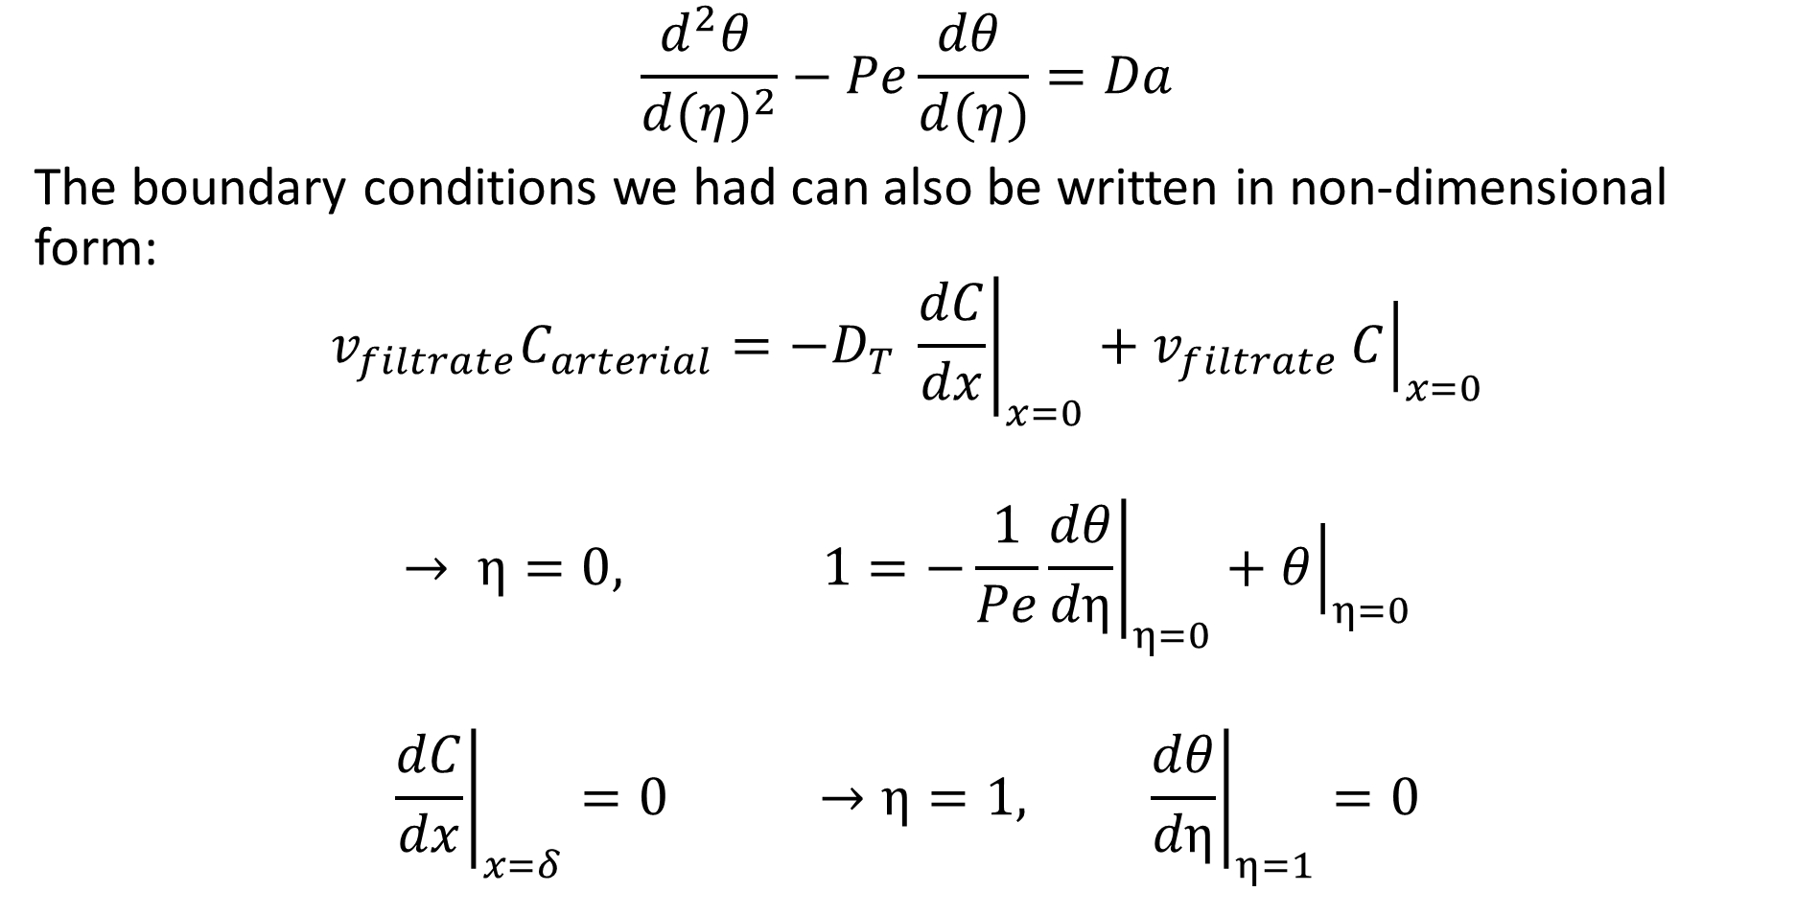
Perfusion Bioreactors – Boundary Conditions
$$\frac{d^{2}θ }{d{(η)}^{2}}−Pe\frac{dθ }{d(η)}=Da$$
The boundary conditions we had can also be written in non-dimensional form:
$$v_{filtrate}C_{arterial}=−D_{T} {\left.\frac{dC}{dx}\right|}_{x=0}+v_{filtrate}{\left.C\right|}_{x=0}$$
$$→ η=0, 1=−\frac{1}{Pe}{\left.\frac{dθ}{dη}\right|}_{η=0}+{\left.θ\right|}_{η=0}$$
$${\left.\frac{dC}{dx}\right|}_{x=δ}=0 →η=1, {\left.\frac{dθ}{dη}\right|}_{η=1}=0$$

Slide 11
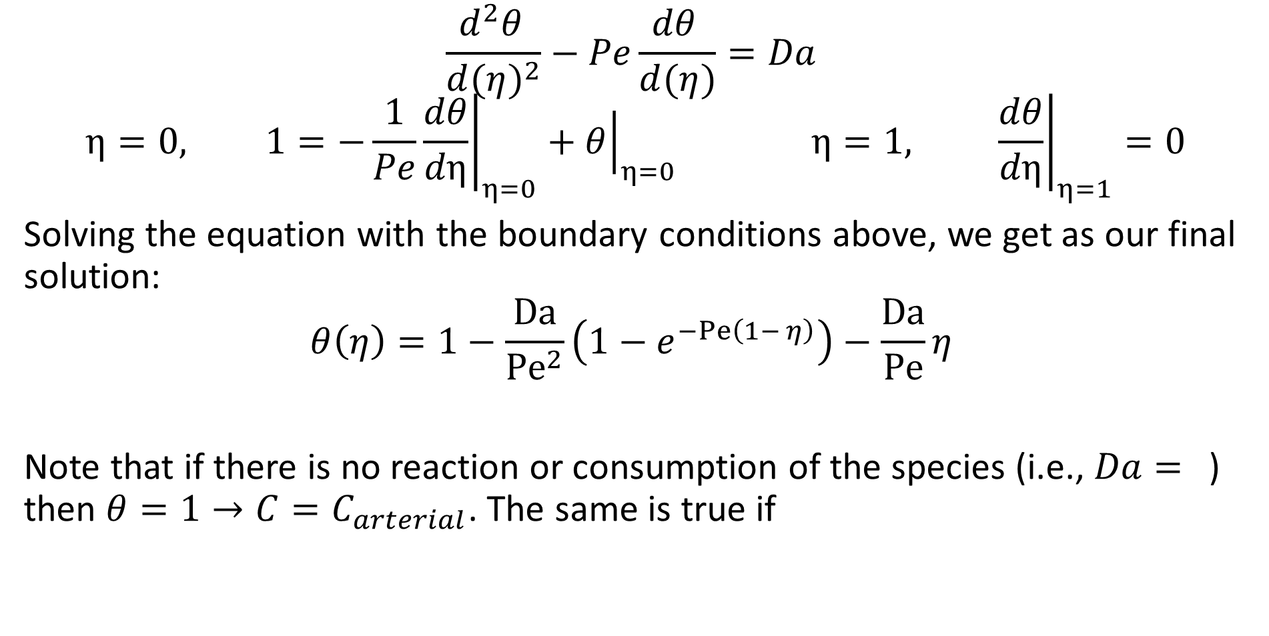
Perfusion Bioreactors – Boundary Conditions
$$\frac{d^{2}θ }{d{(η)}^{2}}−Pe\frac{dθ }{d(η)}=Da$$
$$η=0, 1=−\frac{1}{Pe}{\left.\frac{dθ}{dη}\right|}_{η=0}+{\left.θ\right|}_{η=0} η=1, {\left.\frac{dθ}{dη}\right|}_{η=1}=0$$
Solving the equation with the boundary conditions above, we get as our final solution:
$$θ\left(η\right)=1−\frac{\text{Da}}{{\text{Pe}}^{2}}\left(1−e^{−Pe\left(1− η\right)}\right)−\frac{\text{Da}}{\text{Pe}}η$$
Note that if there is no reaction or consumption of the species (i.e., $Da=$) then $θ=1→C=C_{arterial}$. The same is true if

Slide 12
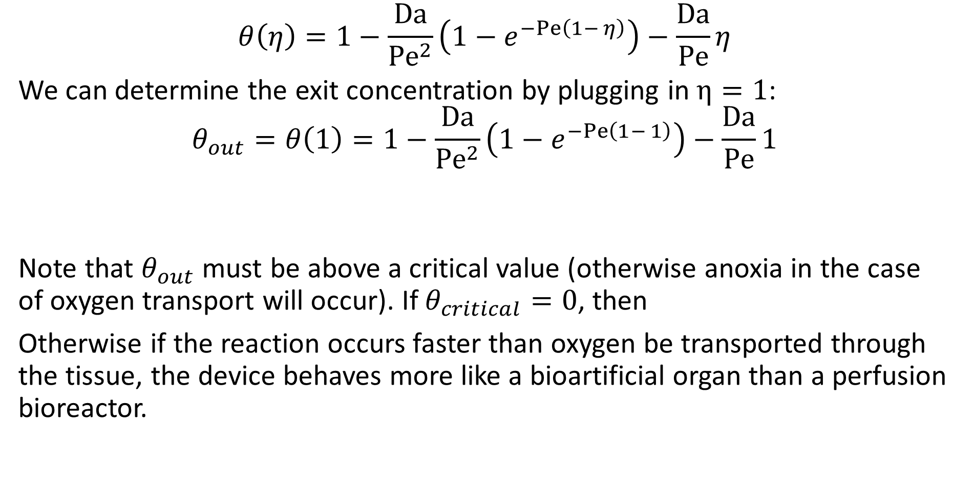
Perfusion Bioreactors – Boundary Conditions
$$θ\left(η\right)=1−\frac{\text{Da}}{{\text{Pe}}^{2}}\left(1−e^{−Pe\left(1− η\right)}\right)−\frac{\text{Da}}{\text{Pe}}η$$
We can determine the exit concentration by plugging in $η=1$:
$$θ_{out}=θ\left(1\right)=1−\frac{\text{Da}}{{\text{Pe}}^{2}}\left(1−e^{−Pe\left(1− 1\right)}\right)−\frac{\text{Da}}{\text{Pe}}1$$
Note that $θ_{out}$ must be above a critical value (otherwise anoxia in the case of oxygen transport will occur). If $θ_{critical}=0$, then
Otherwise if the reaction occurs faster than oxygen be transported through the tissue, the device behaves more like a bioartificial organ than a perfusion bioreactor.

Slide 13
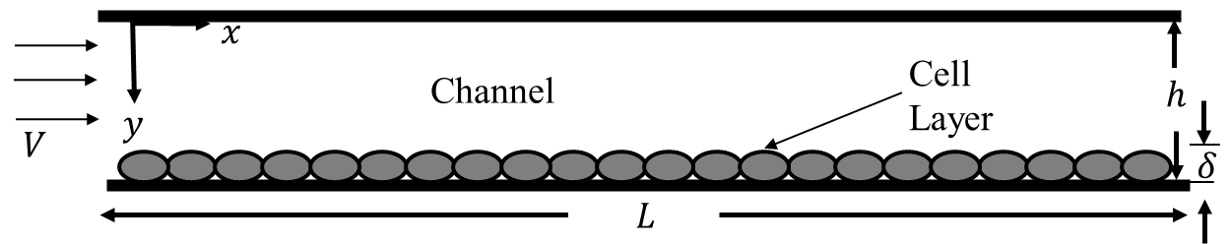
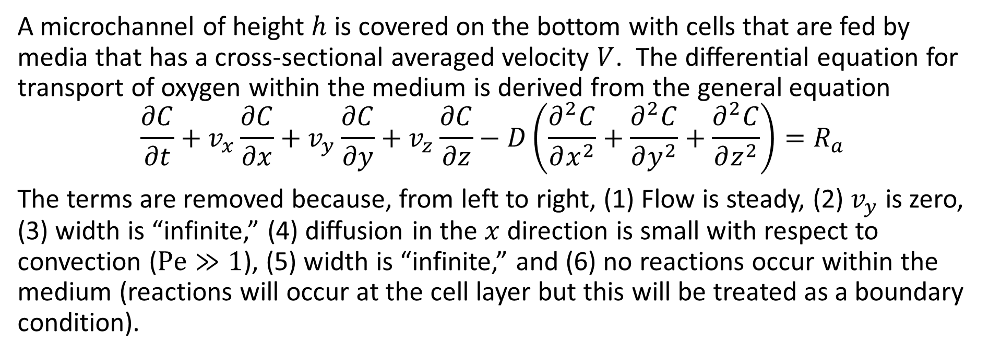
Microchannel Perfusion Bioreactors
A microchannel of height $h$ is covered on the bottom with cells that are fed by media that has a cross-sectional averaged velocity $V$. The differential equation for transport of oxygen within the medium is derived from the general equation
$$\frac{∂C}{∂t}+v_{x}\frac{∂C}{∂x}+v_{y}\frac{∂C}{∂y}+v_{z}\frac{∂C}{∂z}−D\left(\frac{∂^{2}C}{∂x^{2}}+\frac{∂^{2}C}{∂y^{2}}+\frac{∂^{2}C}{∂z^{2}}\right)=R_{a}$$
The terms are removed because, from left to right, (1) Flow is steady, (2) $v_{y}$ is zero, (3) width is “infinite,” (4) diffusion in the $x$ direction is small with respect to convection ($\text{Pe}≫1$), (5) width is “infinite,” and (6) no reactions occur within the medium (reactions will occur at the cell layer but this will be treated as a boundary condition).

Slide 14
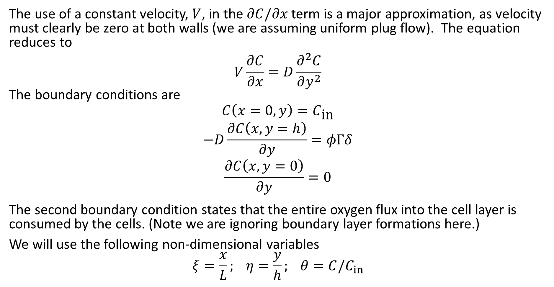
Microchannel Perfusion Bioreactors
The use of a constant velocity, $V$, in the $∂C/∂x$ term is a major approximation, as velocity must clearly be zero at both walls (we are assuming uniform plug flow). The equation reduces to
$$V\frac{∂C}{∂x}=D\frac{∂^{2}C}{∂y^{2}}$$
The boundary conditions are
$$C\left(x=0,y\right)=C_{\text{in}}$$
$$−D\frac{∂C\left(x,y=h\right)}{∂y}=φΓδ$$
$$\frac{∂C\left(x,y=0\right)}{∂y}=0$$
The second boundary condition states that the entire oxygen flux into the cell layer is consumed by the cells. (Note we are ignoring boundary layer formations here.)
We will use the following non-dimensional variables
$$ξ=\frac{x}{L}; η=\frac{y}{h}; θ=C/C_{in}$$

Slide 15
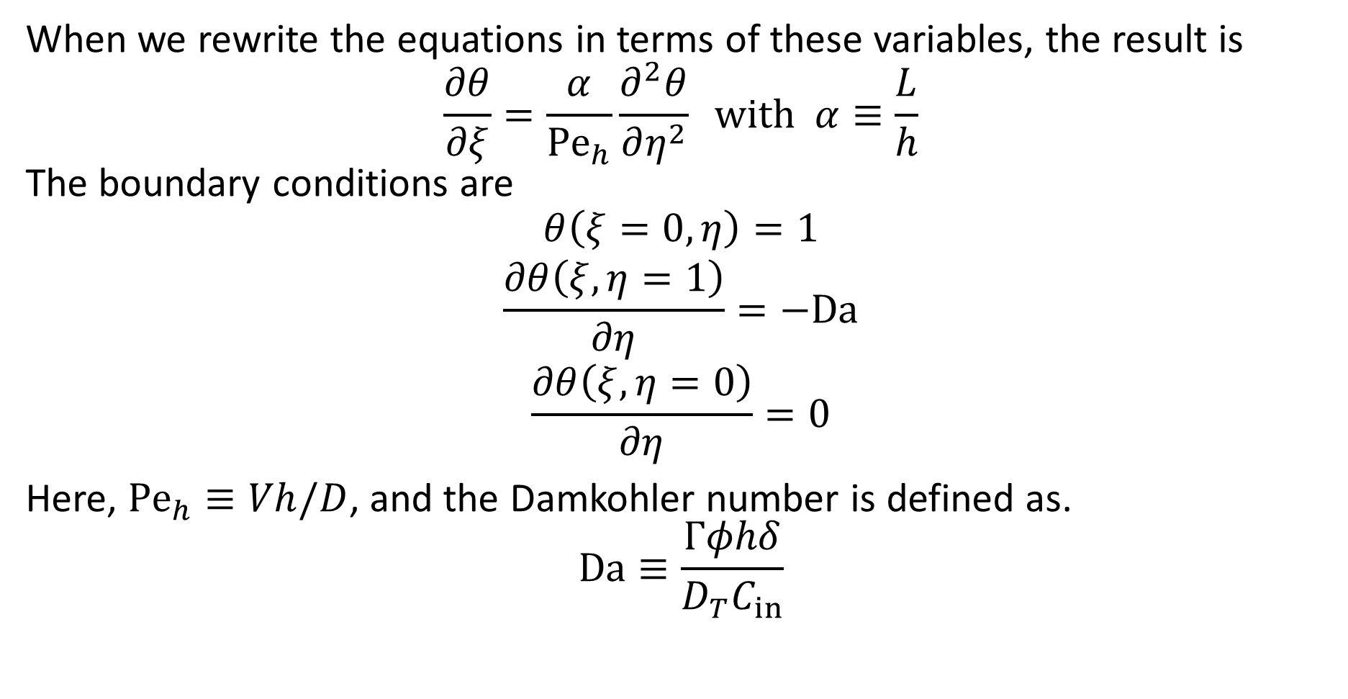
Microchannel Perfusion Bioreactors
When we rewrite the equations in terms of these variables, the result is
$$\frac{∂θ}{∂ξ}=\frac{α}{{\text{Pe}}_{h}}\frac{∂^{2}θ}{∂η^{2}} \text{with} α≡\frac{L}{h}$$
The boundary conditions are
$$θ\left(ξ=0,η\right)=1$$
$$\frac{∂θ\left(ξ,η=1\right)}{∂η}=−\text{Da}$$
$$\frac{∂θ\left(ξ,η=0\right)}{∂η}=0$$
Here, ${\text{Pe}}_{h}≡Vh/D$, and the Damkohler number is defined as.
$$\text{Da}≡\frac{Γφhδ}{D_{T}C_{in}}$$

Slide 16
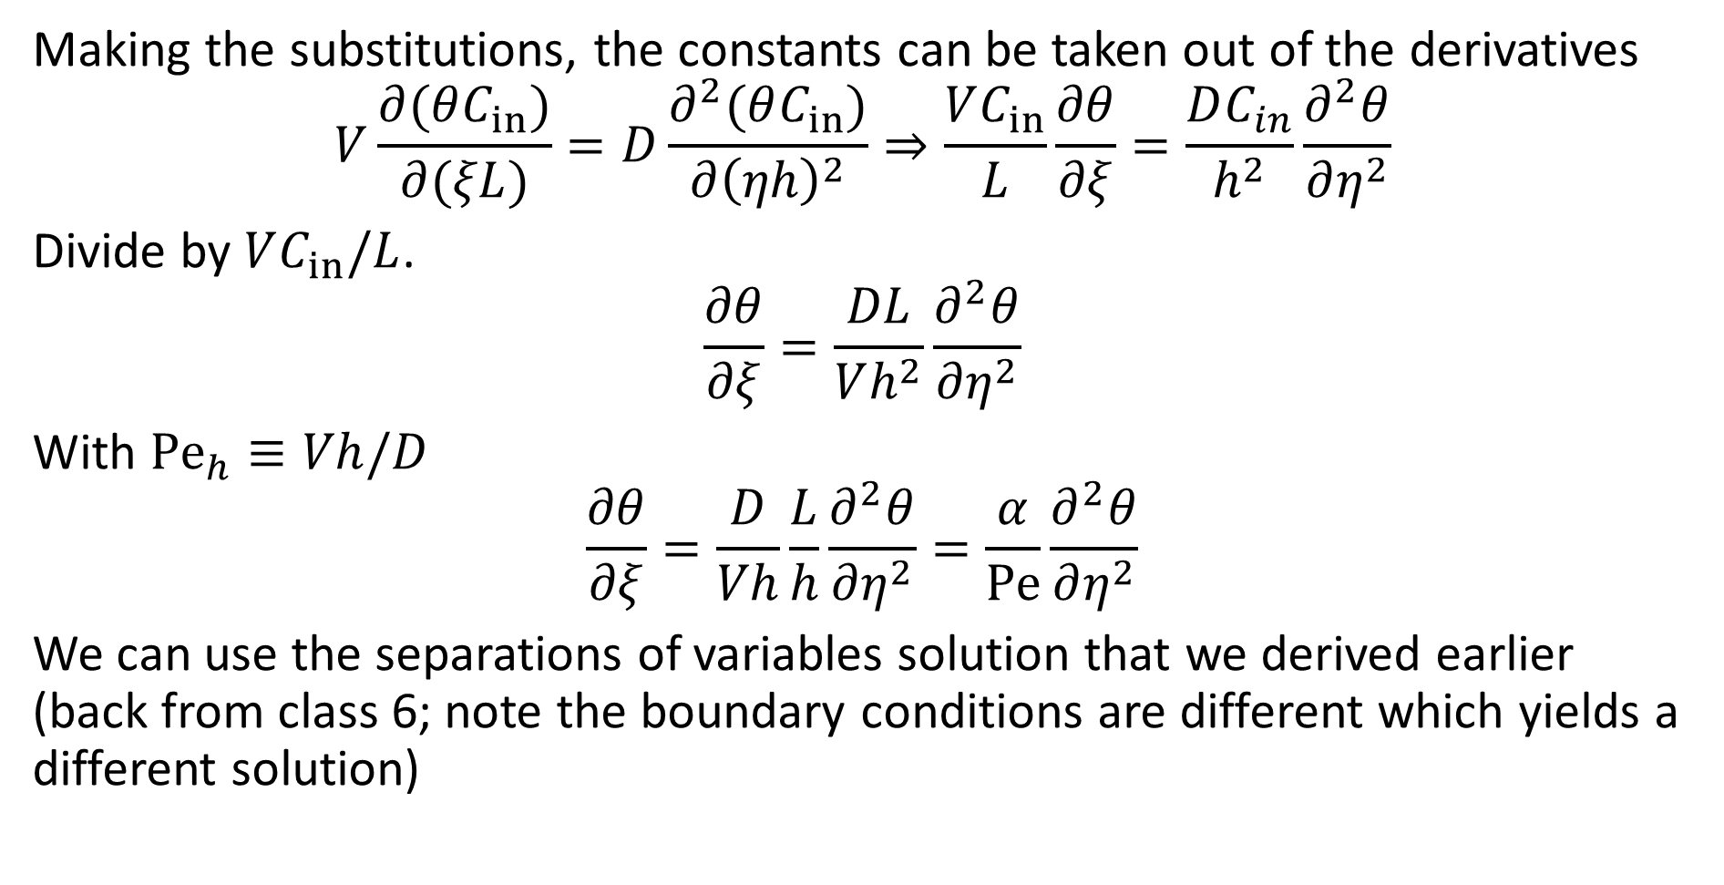
Microchannel Perfusion Bioreactors
Making the substitutions, the constants can be taken out of the derivatives
$$V\frac{∂(θC_{in})}{∂(ξL)}=D\frac{∂^{2}(θC_{in})}{∂{\left(ηh\right)}^{2}}⇒\frac{VC_{in}}{L}\frac{∂θ}{∂ξ}=\frac{DC_{in}}{h^{2}}\frac{∂^{2}θ}{∂η^{2}}$$
Divide by $VC_{in}/L$.
$$\frac{∂θ}{∂ξ}=\frac{DL}{Vh^{2}}\frac{∂^{2}θ}{∂η^{2}}$$
With ${\text{Pe}}_{h}≡Vh/D$
$$\frac{∂θ}{∂ξ}=\frac{D}{Vh}\frac{L}{h}\frac{∂^{2}θ}{∂η^{2}}=\frac{α}{\text{Pe}}\frac{∂^{2}θ}{∂η^{2}}$$
We can use the separations of variables solution that we derived earlier (back from class 6; note the boundary conditions are different which yields a different solution)

Slide 17
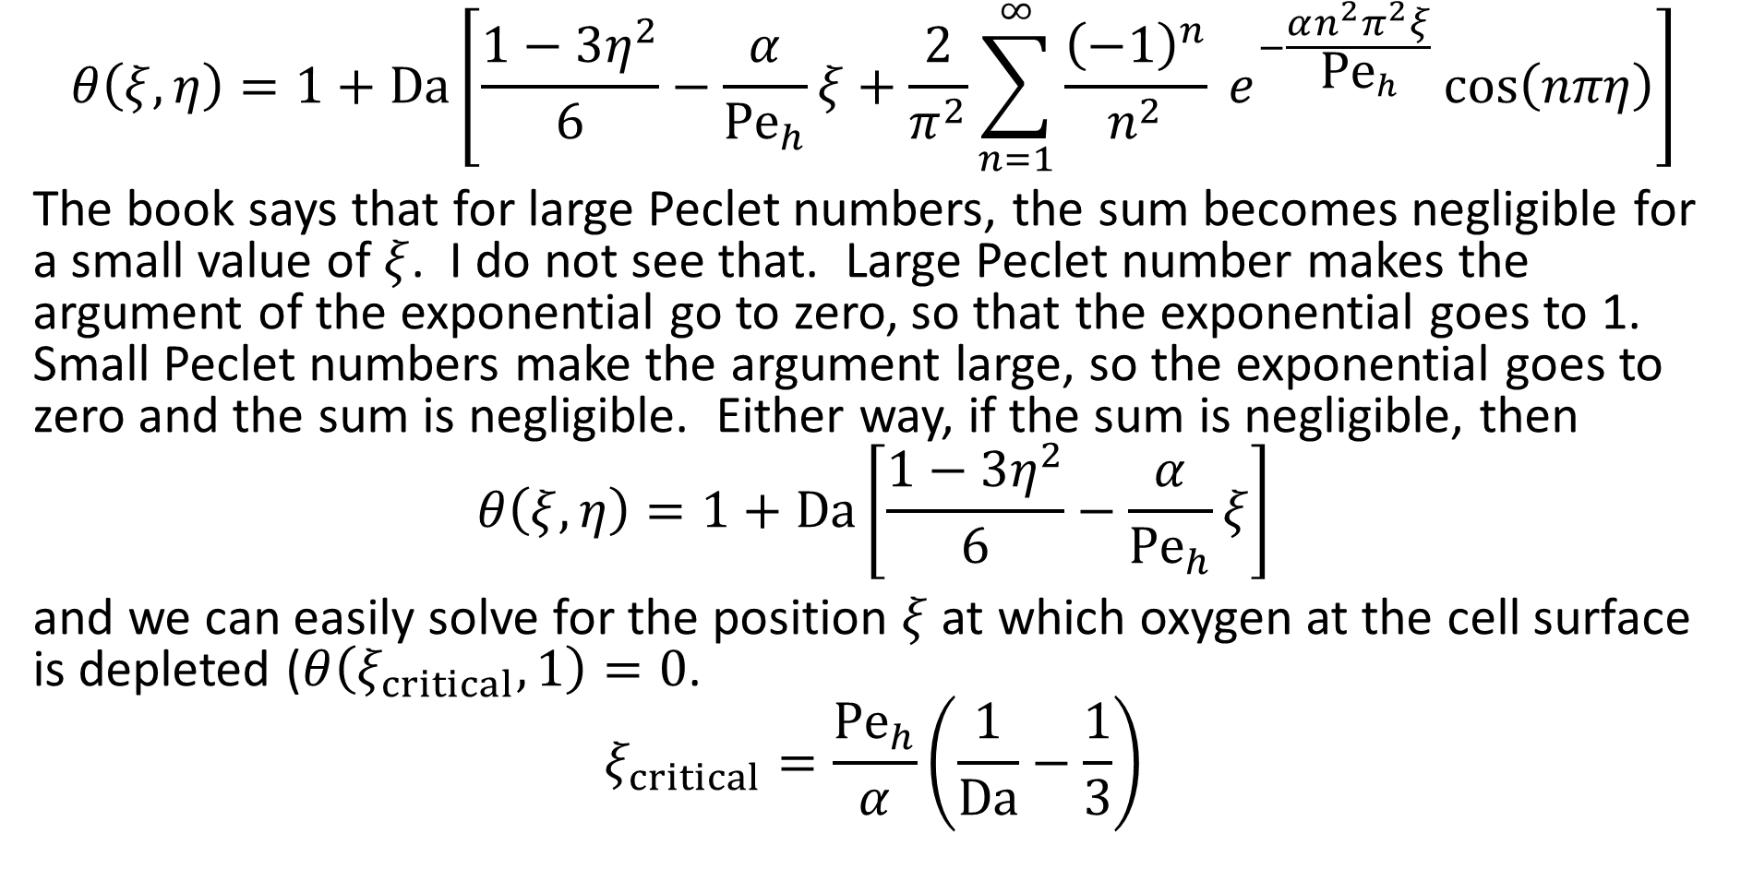
Microchannel Perfusion Bioreactors
$$θ\left(ξ,η\right)=1+\text{Da}\left[\frac{1−3η^{2}}{6}−\frac{α}{{\text{Pe}}_{h}}ξ+\frac{2}{π^{2}}\sum_{n=1}^{∞}{\frac{{\left(−1\right)}^{n}}{n^{2}} e^{−\frac{αn^{2}π^{2}ξ}{{\text{Pe}}_{h}}}\cos\left(nπη\right)}\right]$$
The book says that for large Peclet numbers, the sum becomes negligible for a small value of $ξ$. I do not see that. Large Peclet number makes the argument of the exponential go to zero, so that the exponential goes to 1. Small Peclet numbers make the argument large, so the exponential goes to zero and the sum is negligible. Either way, if the sum is negligible, then
$$θ\left(ξ,η\right)=1+\text{Da}\left[\frac{1−3η^{2}}{6}−\frac{α}{{\text{Pe}}_{h}}ξ\right]$$
and we can easily solve for the position $ξ$ at which oxygen at the cell surface is depleted ($θ\left(ξ_{critical}, 1\right)=0$.
$$ξ_{critical}=\frac{{\text{Pe}}_{h}}{α}\left(\frac{1}{\text{Da}}−\frac{1}{3}\right)$$

Slide 18
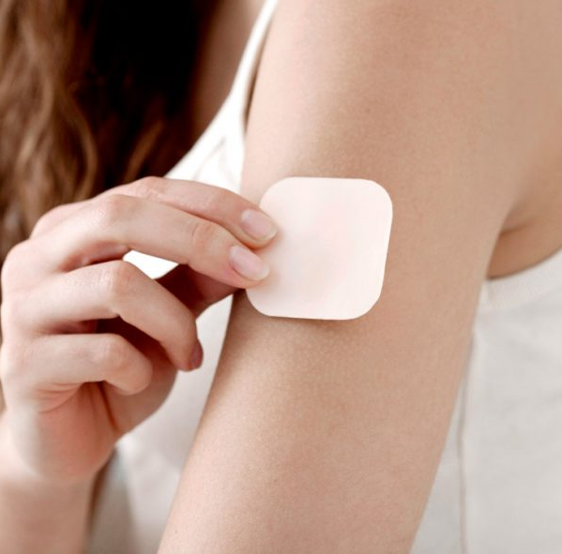
Transdermal Patches for Drug Delivery
Transdermal patches can be used for the controlled release of a drug by providing ________________ drug absorption.
Drug molecules diffuse across the skin and enter the systemic circulation. The passive transport of the drug across the skin is the biggest challenge.
Many drugs have very low skin _____________.
The best drugs for transdermal patches have high pharmacological activity (potency) and good skin permeability (lipophilic).
Common examples of drugs used in transdermal patches include birth control, testosterone/estrogen replacement therapies, motion sickness, and cessation of smoking (i.e., nicotine patches).
Note the same model can be used for cosmetics, but the goal is to minimize skin penetration.

Slide 19
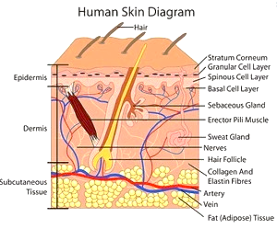
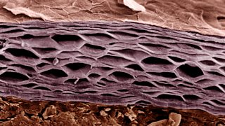
Transdermal Patches for Drug Delivery
The bulk of the resistance for transport of a drug across the skin is in the ____________________ (SC).
The SC is the outermost layer of skin consisting about 15 layers of keratinocytes, with the spaces between cells filled with _____________.

Slide 20
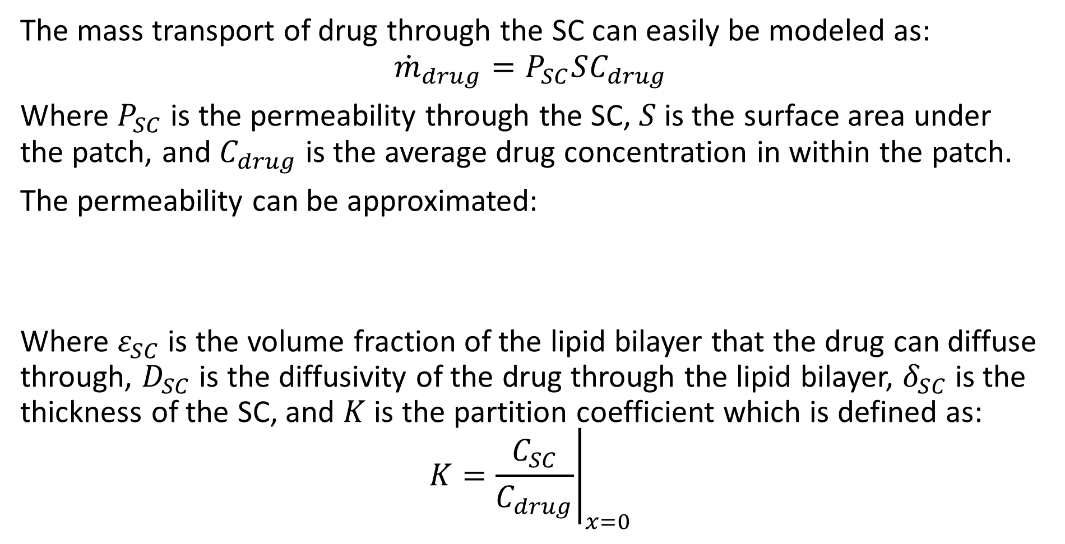
Transdermal Patches for Drug Delivery
The mass transport of drug through the SC can easily be modeled as:
$${\dot{m}}_{drug}=P_{SC}SC_{drug}$$
Where $P_{SC}$ is the permeability through the SC, $S$ is the surface area under the patch, and $C_{drug}$ is the average drug concentration in within the patch.
The permeability can be approximated:
Where $ε_{SC}$ is the volume fraction of the lipid bilayer that the drug can diffuse through, $D_{SC}$ is the diffusivity of the drug through the lipid bilayer, $δ_{SC}$ is the thickness of the SC, and $K$ is the partition coefficient which is defined as:
$$K={\left.\frac{C_{SC}}{C_{drug}}\right|}_{x=0}$$

Slide 21
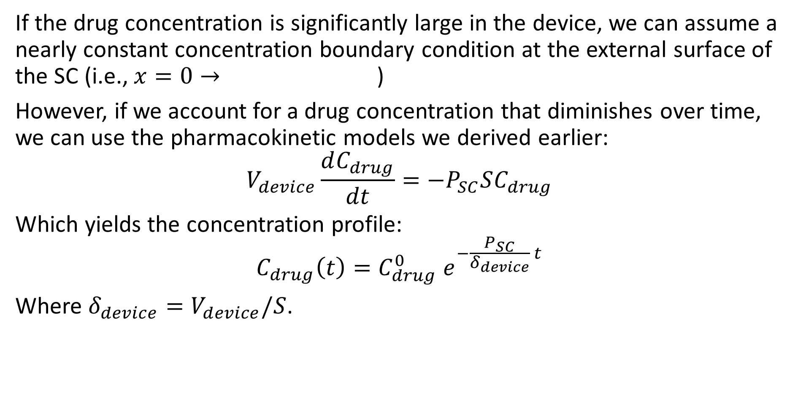
Transdermal Patches for Drug Delivery
If the drug concentration is significantly large in the device, we can assume a nearly constant concentration boundary condition at the external surface of the SC (i.e., $x=0→$)
However, if we account for a drug concentration that diminishes over time, we can use the pharmacokinetic models we derived earlier:
$$V_{device}\frac{dC_{drug}}{dt}=−P_{SC}SC_{drug}$$
Which yields the concentration profile:
$$C_{drug}\left(t\right)=C_{drug}^{0} e^{−\frac{P_{SC}}{δ_{device}} t}$$
Where $δ_{device}=V_{device}/S$.

Slide 22
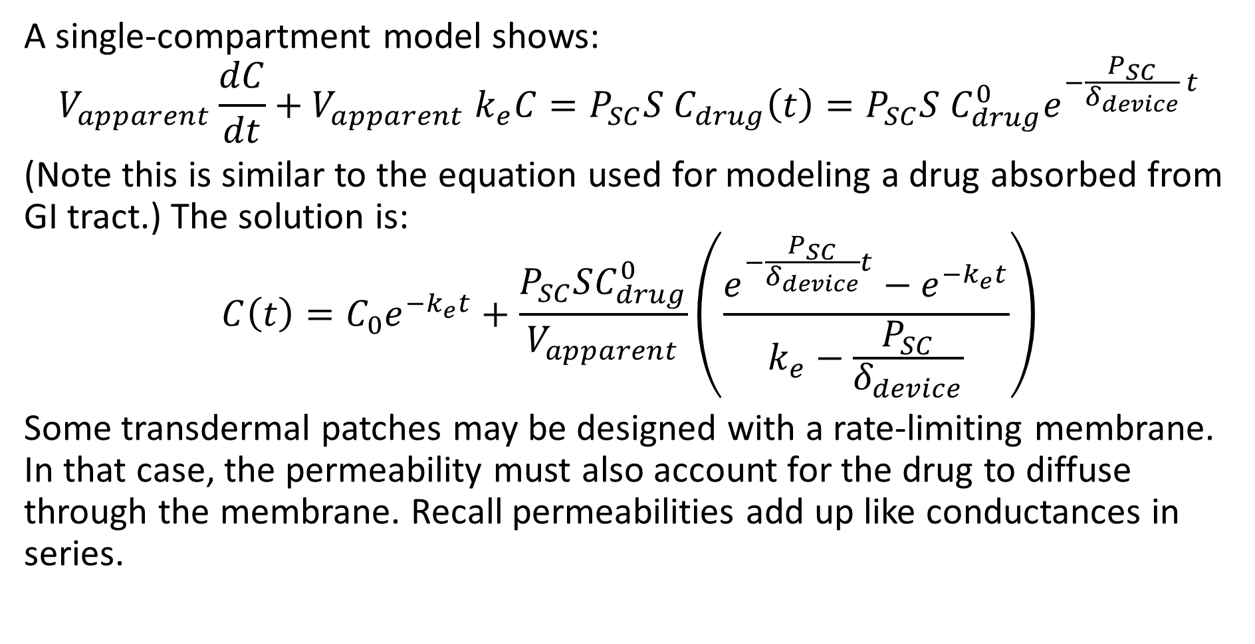
Transdermal Patches for Drug Delivery
A single-compartment model shows:
$$V_{apparent}\frac{dC}{dt}+V_{apparent} k_{e}C=P_{SC}S C_{drug}\left(t\right)=P_{SC}S C_{drug}^{0}e^{−\frac{P_{SC}}{δ_{device}} t}$$
(Note this is similar to the equation used for modeling a drug absorbed from GI tract.) The solution is:
$$C\left(t\right)=C_{0}e^{−k_{e}t}+\frac{P_{SC}SC_{drug}^{0}}{V_{apparent}}\left(\frac{e^{−\frac{P_{SC}}{δ_{device}}t}−e^{−k_{e}t}}{k_{e}−\frac{P_{SC}}{δ_{device}}}\right)$$
Some transdermal patches may be designed with a rate-limiting membrane. In that case, the permeability must also account for the drug to diffuse through the membrane. Recall permeabilities add up like conductances in series.

Slide 23
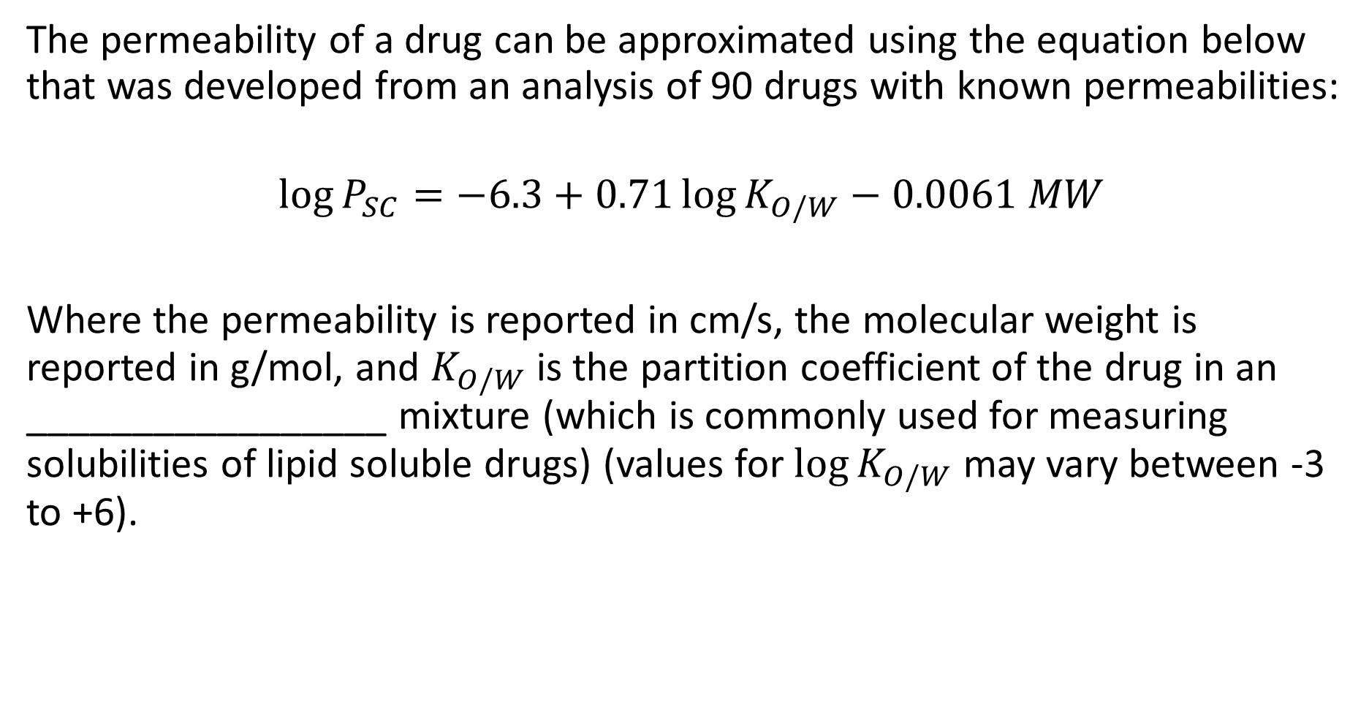
Transdermal Patches for Drug Delivery
The permeability of a drug can be approximated using the equation below that was developed from an analysis of 90 drugs with known permeabilities:
$$\log{P_{SC}}=−6.3+0.71\log{K_{O/W}}−0.0061 MW$$
Where the permeability is reported in cm/s, the molecular weight is reported in g/mol, and $K_{O/W}$ is the partition coefficient of the drug in an _________________ mixture (which is commonly used for measuring solubilities of lipid soluble drugs) (values for $\log{K_{O/W}}$ may vary between -3 to +6).

